Slide 1
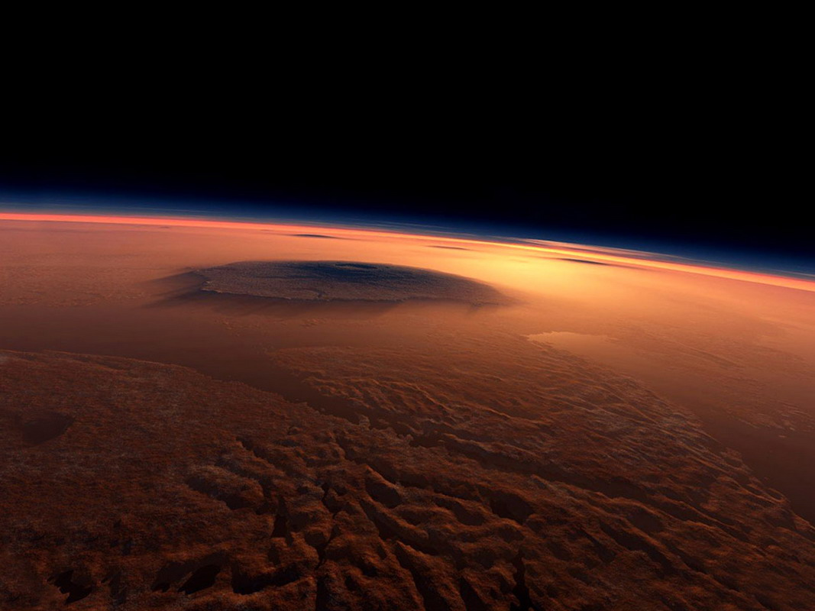
Stars and Mars

Slide 2
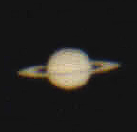
Saturn as seen in the telescope.
Even a small telescope will reveal the rings around Saturn. Up to five of the planet’s moons can also be seen through a good telescope.

Slide 3
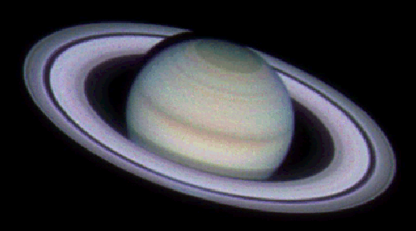
Saturn – Gas Giant
Saturn is the sixth planet from the sun and the second largest planet in our solar system. It is a giant ball of hydrogen and helium gas.

Slide 4
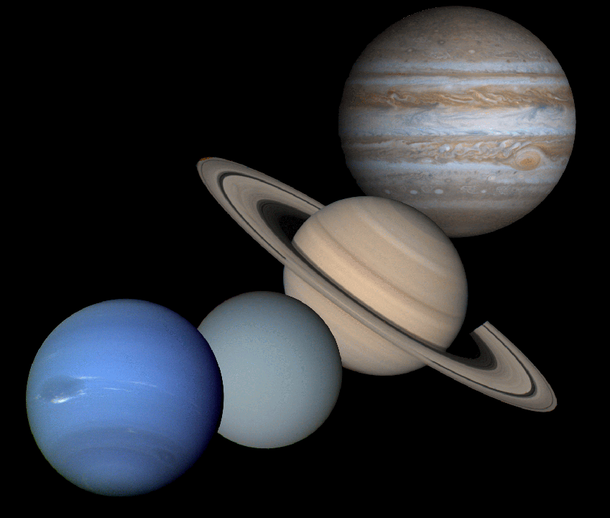
Saturn – Gas Giant
Just like the other three gas-giant planets in our solar system,
Saturn has NO solid
surface …
just gas and clouds that get thicker as you go deeper.

Slide 5
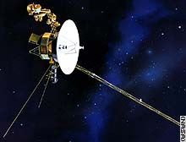
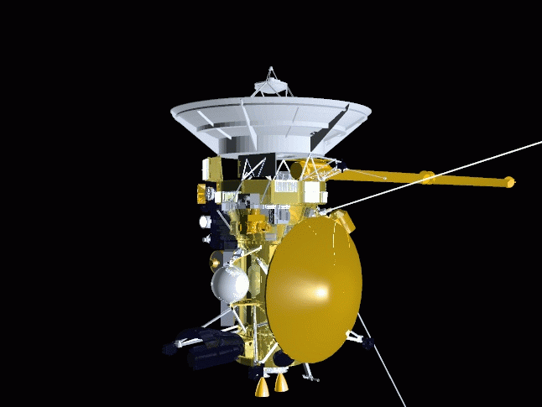
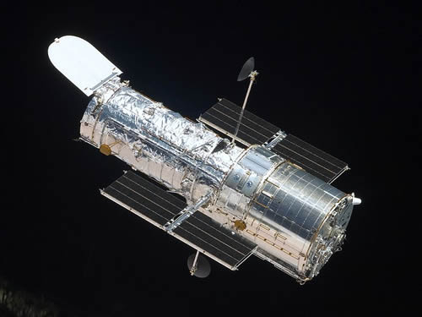
The Last 30 Years
Since 1981 we have learned a LOT about Saturn from various missions. These include (clockwise from the right) Voyager II, the Hubble Space Telescope, and Cassini.
Voyager II
August, 1981
Cassini / Huygens
July, 2004
Hubble Space Telescope
April, 1990

Slide 6
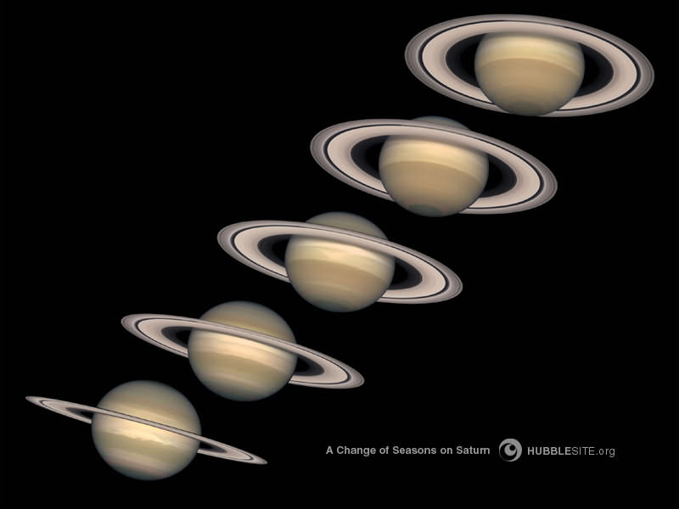
Saturn’s Rings Change
Saturn’s axis of rotation is tilted
27° relative to its orbital plane, similar to Earth’s 23° tilt.
2000
1999
1998
1997
As Saturn makes its 29.5-year journey around the Sun, first one hemisphere, and then the other is tilted towards the Sun and Earth.
1996

Slide 7
Saturn’s Rings Change
So, as the planet circles the Sun, the plane of its rings also changes in relation
to the Sun and Earth.
2000
1999
1998
1997
1996
That's why we get different views of the rings.

Slide 8
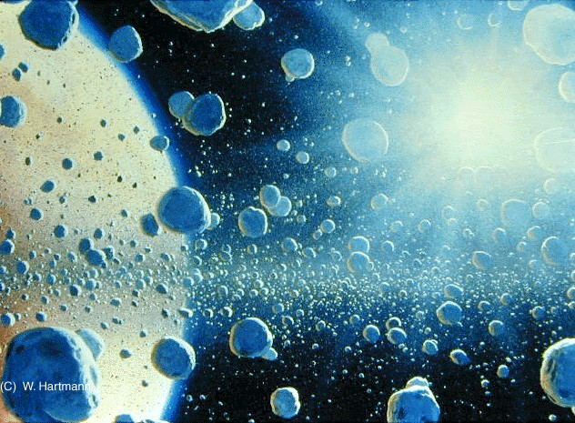
What Are the Rings Made Of
The rings are made of dusty water ice, which range in size from boulders to sand grains.
Artist’s conception of the rings’ composition.
Saturn's gravitational field constantly disrupts these ice chunks, keeping them spread out and preventing them from combining to form a moon.

Slide 9
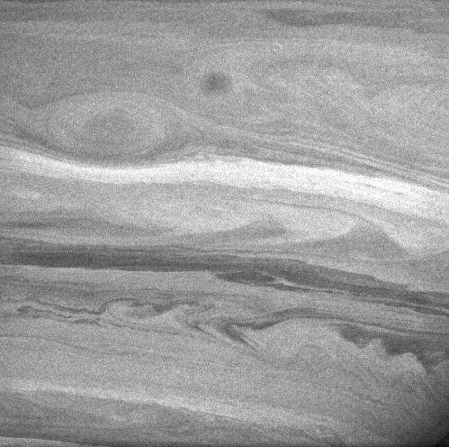
Saturn’s Cloud Layers
It is difficult to see cloud features on Saturn because the lower layers of clouds are obscured by high level haze.
This Cassini image, taken with the visual infrared mapping spectrometer, shows cloud bands and features in the lower parts of Saturn’s atmosphere that were previously unknown.

Slide 10
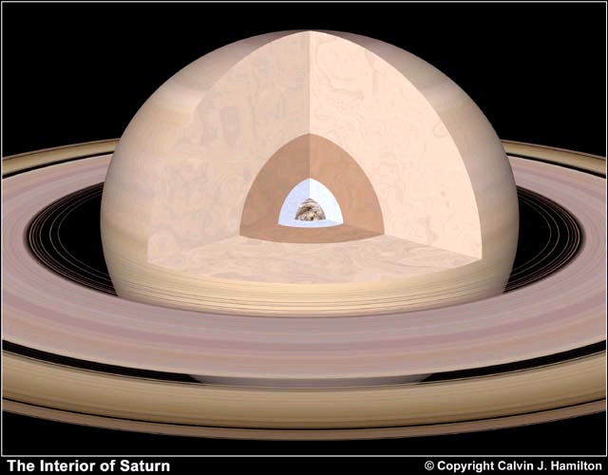
Saturn’s Solid Core
Saturn may have a solid, rocky core. If so, it would be about twice the size of Earth but 10 times its mass.

Slide 11
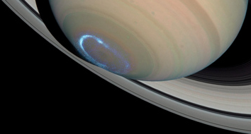
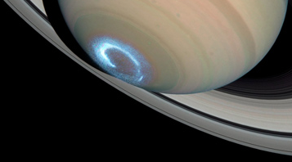
Aurora’s on Saturn?!
Saturn has a very strong magnetic field. This causes auroras near its poles.
This Hubble image shows how an aurora changes and flickers as a solar storm passes through.

Slide 12
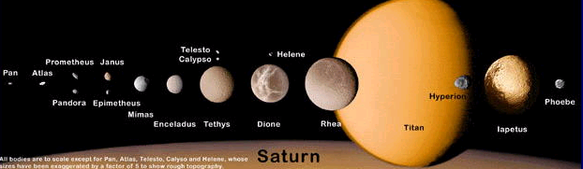
Saturn’s Moons
Saturn has over 52 known moons and another 8 possible moonlets in orbit around the planet.

Slide 13
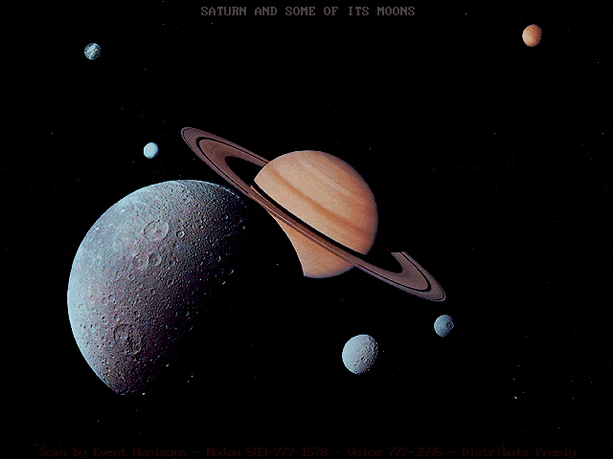
Saturn’s Moons
Most of Saturn’s moons are balls of ice with rocky cores.
Unlike Saturn, they have solid surfaces which can become cratered.

Slide 14
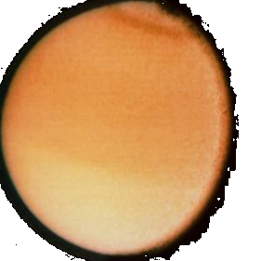
Saturn’s Moons - Titan
The largest of Saturn’s moons is Titan. It is the second largest moon in our solar system and
a little larger than Mercury.
Titan’s atmosphere is about 95% nitrogen and 5% methane.

Slide 15
Saturn’s Moons - Titan
Most of what we know about Titan came from the Cassini / Huygens mission. Huygens actually landed on Titan’s surface!

Slide 16
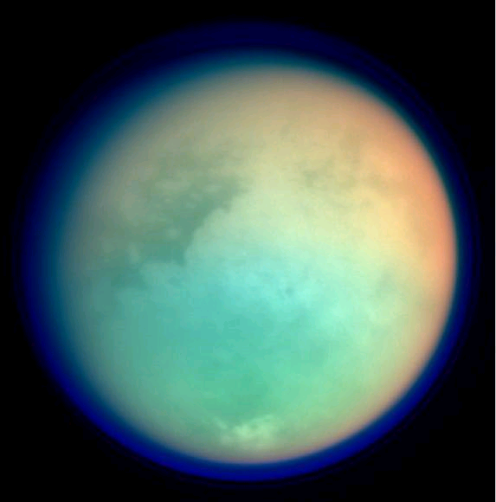
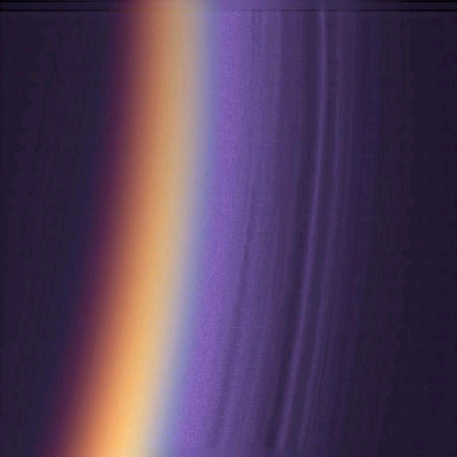
Saturn’s Moons - Titan
Because Titan’s surface is covered with clouds of methane gas, we can't see its surface.
These false color images show the details of the smog haze layers in Titan’s atmosphere.

Slide 17
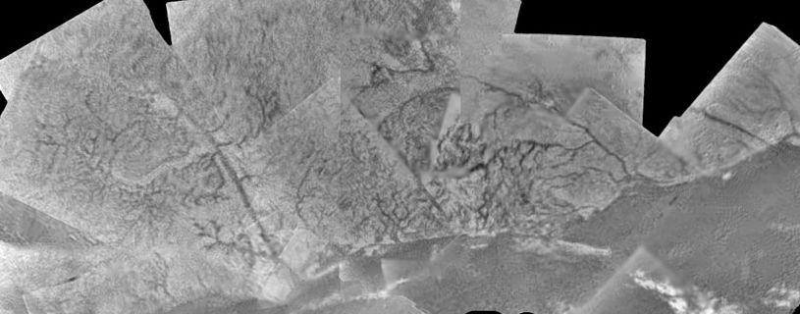
Saturn’s Moons - Titan
In January 2005, the Huygens probe penetrated Titan's clouds and landed on its surface.
This image shows a complex world with ice mountains, methane river channels and lakes.

